Slide 1
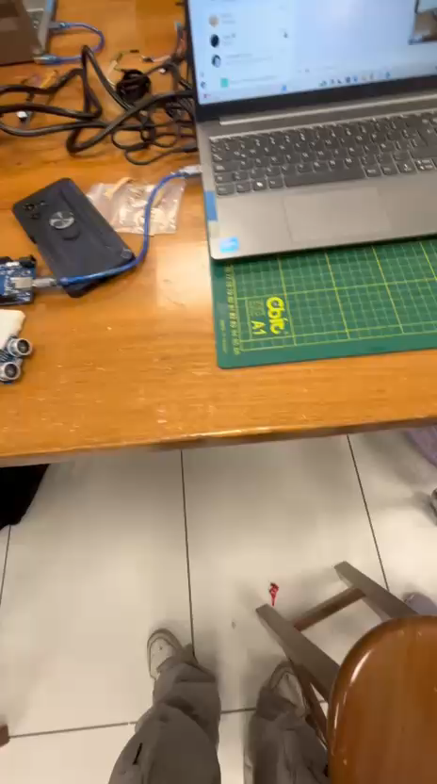
T2

Slide 2
